Slide 1
Processes
Tanenbaum, Modern Operating Systems 3 e, (c) 2008 Prentice-Hall, Inc. All rights reserved. 0-13-6006639

Slide 2
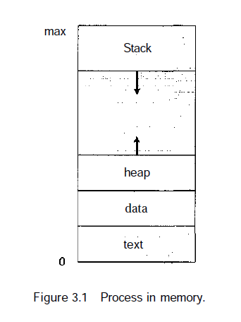
What is a process?
An instance of a program, replete with registers, variables, and a program counter
It has a program, input, output and a state
Why is this idea necessary?
  A computer manages many computations concurrently-need an abstraction to describe how it does it
> Contains program code, which is sometimes known as the text section. It also includes the current activity, as represented by the value of the program counter and the contents of the processor's registers.
> A process generally also includes the process stack, which contains temporary data (such as function parameters, return addresses, and local variables)
> A data section, which contains global variables.
>A process may also include a heap, which is memory
that is dynamically allocated during process run time.
* Galvin Chapter 3, Sec: 3.1.1

Slide 3

Multiprogramming
* pseudoparallelism
(a) Multiprogramming of four programs. (b) Conceptual model of four independent, sequential processes. (c) Only one program is active at once.
Tanenbaum, Modern Operating Systems 3 e, (c) 2008 Prentice-Hall, Inc. All rights reserved. 0-13-6006639

Slide 4
Process Creation
Events which can cause process creation
System initialization.
Execution of a process creation system call by a running process.
A user request to create a new process.
Initiation of a batch job.
Tanenbaum, Modern Operating Systems 3 e, (c) 2008 Prentice-Hall, Inc. All rights reserved. 0-13-6006639

Slide 5
Process Termination
Events which cause process termination:
Normal exit (voluntary).
Error exit (voluntary).
Fatal error (involuntary).
Killed by another process (involuntary).
Tanenbaum, Modern Operating Systems 3 e, (c) 2008 Prentice-Hall, Inc. All rights reserved. 0-13-6006639

Slide 6
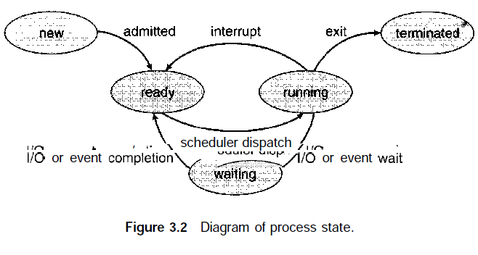
Process States
* Galvin Chapter 3, Sec: 3.1
A process can be in running, blocked, or ready state. Transitions between these states are as shown.
Tanenbaum, Modern Operating Systems 3 e, (c) 2008 Prentice-Hall, Inc. All rights reserved. 0-13-6006639

Slide 7
New. The process is being created.
• Running. Instructions are being executed.
• Waiting. The process is waiting for some event to occur (such as an I/O
completion or reception of a signal).
• Ready. The process is waiting to be assigned to a processor.
• Terminated. The process has finished execution.

Slide 8
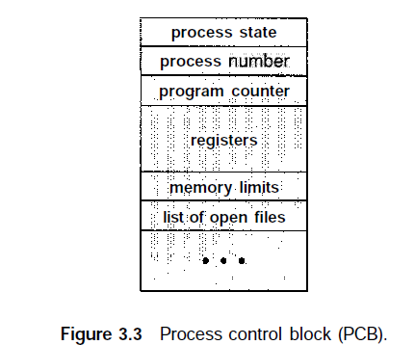
Process Conrol Block (PCB)
* Galvin Chapter 3, Sec: 3.1
Tanenbaum, Modern Operating Systems 3 e, (c) 2008 Prentice-Hall, Inc. All rights reserved. 0-13-6006639

Slide 9
* Galvin Chapter 3, Sec: 3.1
Process Conrol Block (PCB)
Process state. The state may be new, ready, running, waiting, halted, and so on.
Program counter. The counter indicates the address of the next instruction to be executed for this process.
• CPU registers. They include accumulators, index registers, stack pointers, and general-purpose registers, plus any condition-code information. Along with the program counter, this state information must be saved when an interrupt occurs, to allow the process to be continued correctly afterward
• CPU-scheduling information. This information includes a process priority, pointers to scheduling queues, and any other scheduling parameters.
Tanenbaum, Modern Operating Systems 3 e, (c) 2008 Prentice-Hall, Inc. All rights reserved. 0-13-6006639

Slide 10
* Galvin Chapter 3, Sec: 3.1
Process Conrol Block (PCB)
• Memory-management information. This information may include such information as the value of the base and limit registers, the page tables, or the segment tables, depending on the memory system used by the operating system
• Accounting information. This information includes the amount of CPU and real time used, time limits, job or process numbers etc.
• I/O status information. This information includes the list of I/O devices allocated to the process, a list of open files, and so on.
Tanenbaum, Modern Operating Systems 3 e, (c) 2008 Prentice-Hall, Inc. All rights reserved. 0-13-6006639

Slide 11
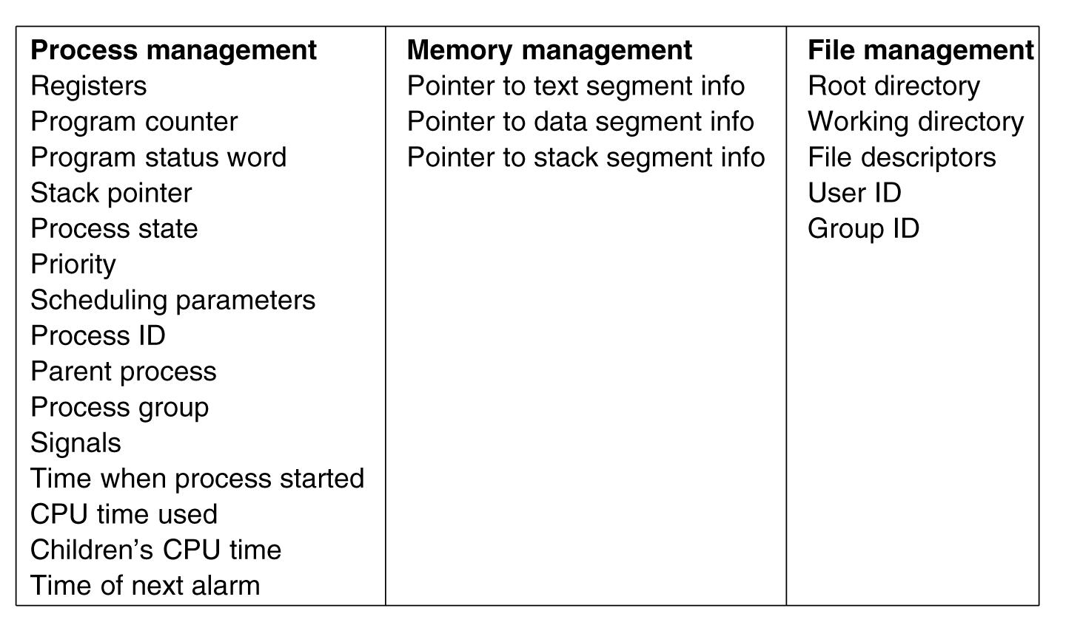
Tanenbaum, Modern Operating Systems 3 e, (c) 2008 Prentice-Hall, Inc. All rights reserved. 0-13-6006639

Slide 12
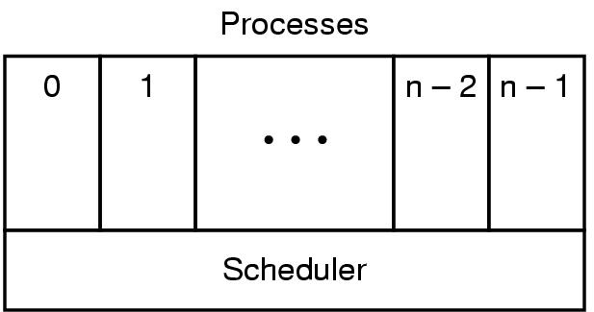
Implementation of Processes (1)
The lowest layer of a process-structured operating system handles interrupts and scheduling. Above that layer are sequential processes.
Tanenbaum, Modern Operating Systems 3 e, (c) 2008 Prentice-Hall, Inc. All rights reserved. 0-13-6006639

Slide 13

How multiprogramming performs
Suppose that a process spends a fraction p of its time waiting for I/O to complete.
With n processes in memory at once, the probability that all n processes are waiting for I/O (in which case the CPU will be idle) is pn
The CPU utilization is then given by the formula
Tanenbaum, Modern Operating Systems 3 e, (c) 2008 Prentice-Hall, Inc. All rights reserved. 0-13-6006639

Slide 14
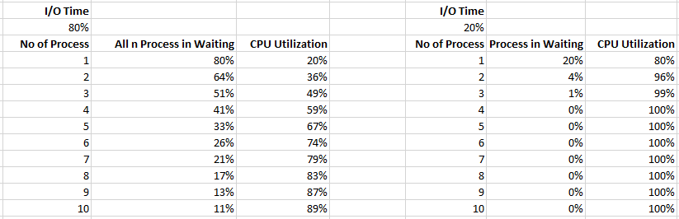
How multiprogramming performs
Tanenbaum, Modern Operating Systems 3 e, (c) 2008 Prentice-Hall, Inc. All rights reserved. 0-13-6006639

Slide 15
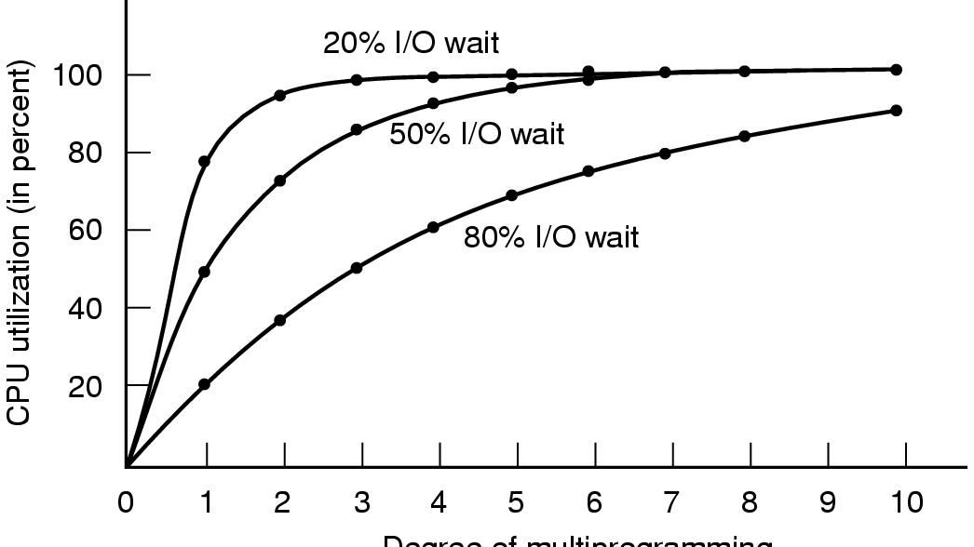
How multiprogramming performs
CPU utilization as a function of the number of processes in memory.
Tanenbaum, Modern Operating Systems 3 e, (c) 2008 Prentice-Hall, Inc. All rights reserved. 0-13-6006639

Slide 16
How multiprogramming performs
>> From the figure it is clear that if processes spend 80% of their time waiting for I/O, at least 10 processes must be in memory at once to get the CPU waste below
10%.
>> I/O wait times of 80% and more are not unusual.
Tanenbaum, Modern Operating Systems 3 e, (c) 2008 Prentice-Hall, Inc. All rights reserved. 0-13-6006639

Slide 17
Interprocess Communication
Three problems
    How to actually do it
    How to deal with process conflicts (2 airline reservations for same seat)
    How to do correct sequencing when dependencies are present-aim the gun before firing it
SAME ISSUES FOR THREADS AS FOR PROCESSES-SAME SOLUTIONS AS WELL
Proceed to discuss these problems
.
Tanenbaum, Modern Operating Systems 3 e, (c) 2008 Prentice-Hall, Inc. All rights reserved. 0-13-6006639

Slide 18

Race Conditions
In is local variable containing pointer to next free slot
Out is local variable pointing to next file to be printed
Tanenbaum, Modern Operating Systems 3 e, (c) 2008 Prentice-Hall, Inc. All rights reserved. 0-13-6006639
Notes:
Printer daemon prints processes and spooler directory contains files

Slide 19
How to avoid races
Mutual exclusion–only one process at a time can use a shared variable/file
Critical regions-shared memory which leads to races
Solution- Ensure that two processes can’t be in the critical region at the same time
.
Tanenbaum, Modern Operating Systems 3 e, (c) 2008 Prentice-Hall, Inc. All rights reserved. 0-13-6006639

Slide 20
Properties of a good solution
1. Mutual exclusion
2. No assumptions about speeds or number of CPU’s
3. No process outside critical region can block other processes
4. No starvation-no process waits forever to enter critical region
.
Tanenbaum, Modern Operating Systems 3 e, (c) 2008 Prentice-Hall, Inc. All rights reserved. 0-13-6006639

Slide 21

What we are trying to do
Tanenbaum, Modern Operating Systems 3 e, (c) 2008 Prentice-Hall, Inc. All rights reserved. 0-13-6006639

Slide 22
First attempts-Busy Waiting
A laundry list of proposals to achieve mutual exclusion
Disabling interrupts
Lock variables
Strict alternation
Peterson's solution
The TSL instruction
Tanenbaum, Modern Operating Systems 3 e, (c) 2008 Prentice-Hall, Inc. All rights reserved. 0-13-6006639

Slide 23
Disabling Interrupts
Idea: process disables interrupts, enters cr, enables interrupts when it leaves cr
Problems
  Process might never enable interrupts, crashing system
  Won’t work on multi-core chips as disabling interrupts only effects one CPU at a time
Tanenbaum, Modern Operating Systems 3 e, (c) 2008 Prentice-Hall, Inc. All rights reserved. 0-13-6006639

Slide 24
Lock variables
A software solution-everyone shares a lock
  When lock is 0, process turns it to 1 and enters cr
  When exit cr, turn lock to 0
Problem-Race condition still exists for the lock variable itself
Tanenbaum, Modern Operating Systems 3 e, (c) 2008 Prentice-Hall, Inc. All rights reserved. 0-13-6006639

Slide 25
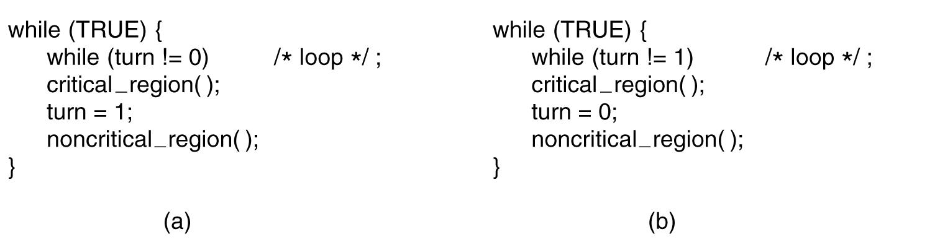
Strict Alternation
First me, then you
Tanenbaum, Modern Operating Systems 3 e, (c) 2008 Prentice-Hall, Inc. All rights reserved. 0-13-6006639

Slide 26
Problems with strict alternation
Employs busy waiting-while waiting for the cr, a process spins
If one process is outside the cr and it is its turn, then other process has to wait until outside guy finishes both outside AND inside (cr) work
Breaks the scheduling property ( no. 3)
Tanenbaum, Modern Operating Systems 3 e, (c) 2008 Prentice-Hall, Inc. All rights reserved. 0-13-6006639

Slide 27
Problems with strict alternation
Process 0 runs, enters its critical section and exits; setting turn to 1. Process 0 is now in its non-critical section. Assume this non-critical procedure takes a long time.
Process 1, which is a much faster process, now runs and once it has left its critical section turn is set to zero.
Process 1 executes its non-critical section very quickly and returns to the top of the procedure.
The situation is now that process 0 is in its non-critical section and process 1 is waiting for turn to be set to zero. In fact, there is no reason why process 1 cannot enter its critical region as process 0 is not in its critical region.
Tanenbaum, Modern Operating Systems 3 e, (c) 2008 Prentice-Hall, Inc. All rights reserved. 0-13-6006639

Slide 28
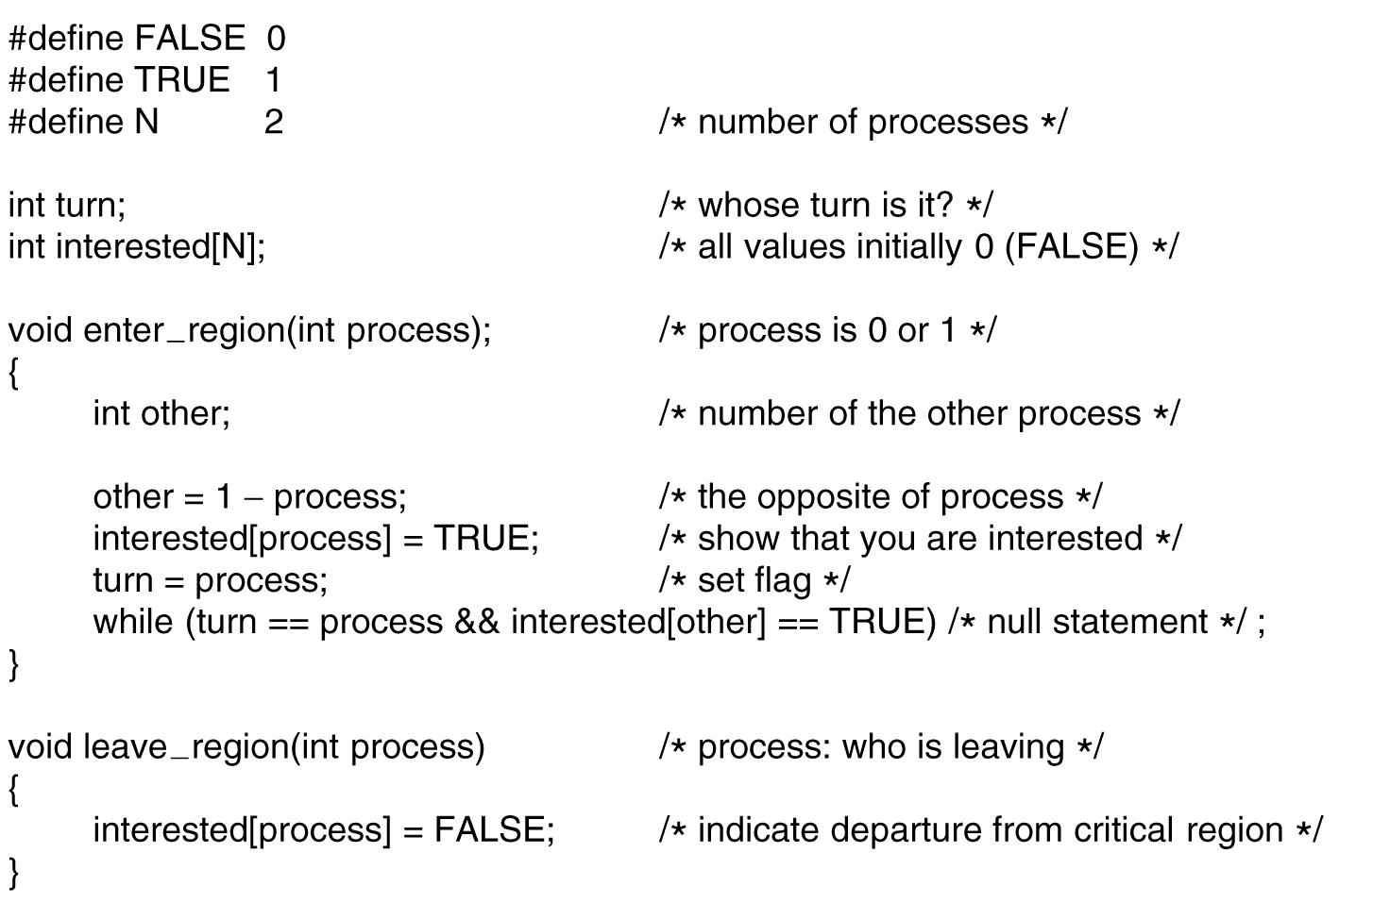
Peterson's Solution
.
Tanenbaum, Modern Operating Systems 3 e, (c) 2008 Prentice-Hall, Inc. All rights reserved. 0-13-6006639

Slide 29
Peterson
Process 0 & 1 try to get in simultaneously
Last one in sets turn: say it is process 1
Process 0 enters (turn= = process is False)
Tanenbaum, Modern Operating Systems 3 e, (c) 2008 Prentice-Hall, Inc. All rights reserved. 0-13-6006639

Slide 30
TSL
TSL reads lock into register and stores NON ZERO VALUE in lock (e.g. process number)
Instruction is atomic: done by freezing access to bus line (bus disable)
Tanenbaum, Modern Operating Systems 3 e, (c) 2008 Prentice-Hall, Inc. All rights reserved. 0-13-6006639

Slide 31
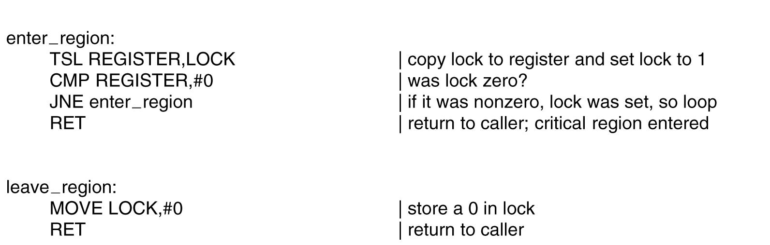
Using TSL
JNE = Jump if not equal
ZF=0 then jump
TSL is atomic. Memory bus is locked until it is finished executing.
Tanenbaum, Modern Operating Systems 3 e, (c) 2008 Prentice-Hall, Inc. All rights reserved. 0-13-6006639

Slide 32
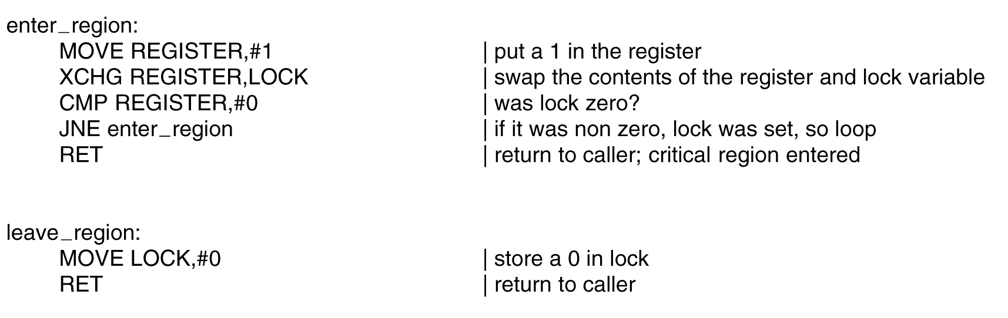
XCHG instruction
Xchg a,b exchanges a & b
Tanenbaum, Modern Operating Systems 3 e, (c) 2008 Prentice-Hall, Inc. All rights reserved. 0-13-6006639

Slide 33
What’s wrong with Peterson, TSL ,XCHG?
Busy waiting-waste of CPU time!
Priority Inversion problem
Consider a computer with two processes, H, with high priority, and L, with low priority. The scheduling rules are such that H is run whenever it is in ready state. At a certain moment, with L in its critical region, H becomes ready to run (e.g., an I/O operation completes). H now begins busy waiting, but since L is never scheduled while H is running, L never gets the chance to leave its critical region, so
H loops forever.
Tanenbaum, Modern Operating Systems 3 e, (c) 2008 Prentice-Hall, Inc. All rights reserved. 0-13-6006639

Slide 34
Using Sleep and Wakeup instead of busy waiting
Idea: Replace busy waiting by blocking calls
Sleep is a system call that causes the caller to block, that is, be suspended until another process wakes it up.
Wakeup unblocks process
A wakeups call to a process is lost if that process is not in sleep

Slide 35
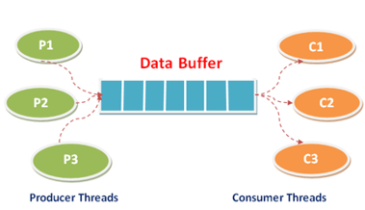
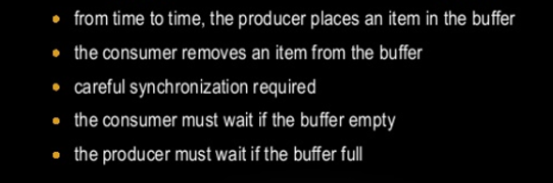
The Producer-Consumer Problem (aka Bounded Buffer Problem)
Tanenbaum, Modern Operating Systems 3 e, (c) 2008 Prentice-Hall, Inc. All rights reserved. 0-13-6006639

Slide 36
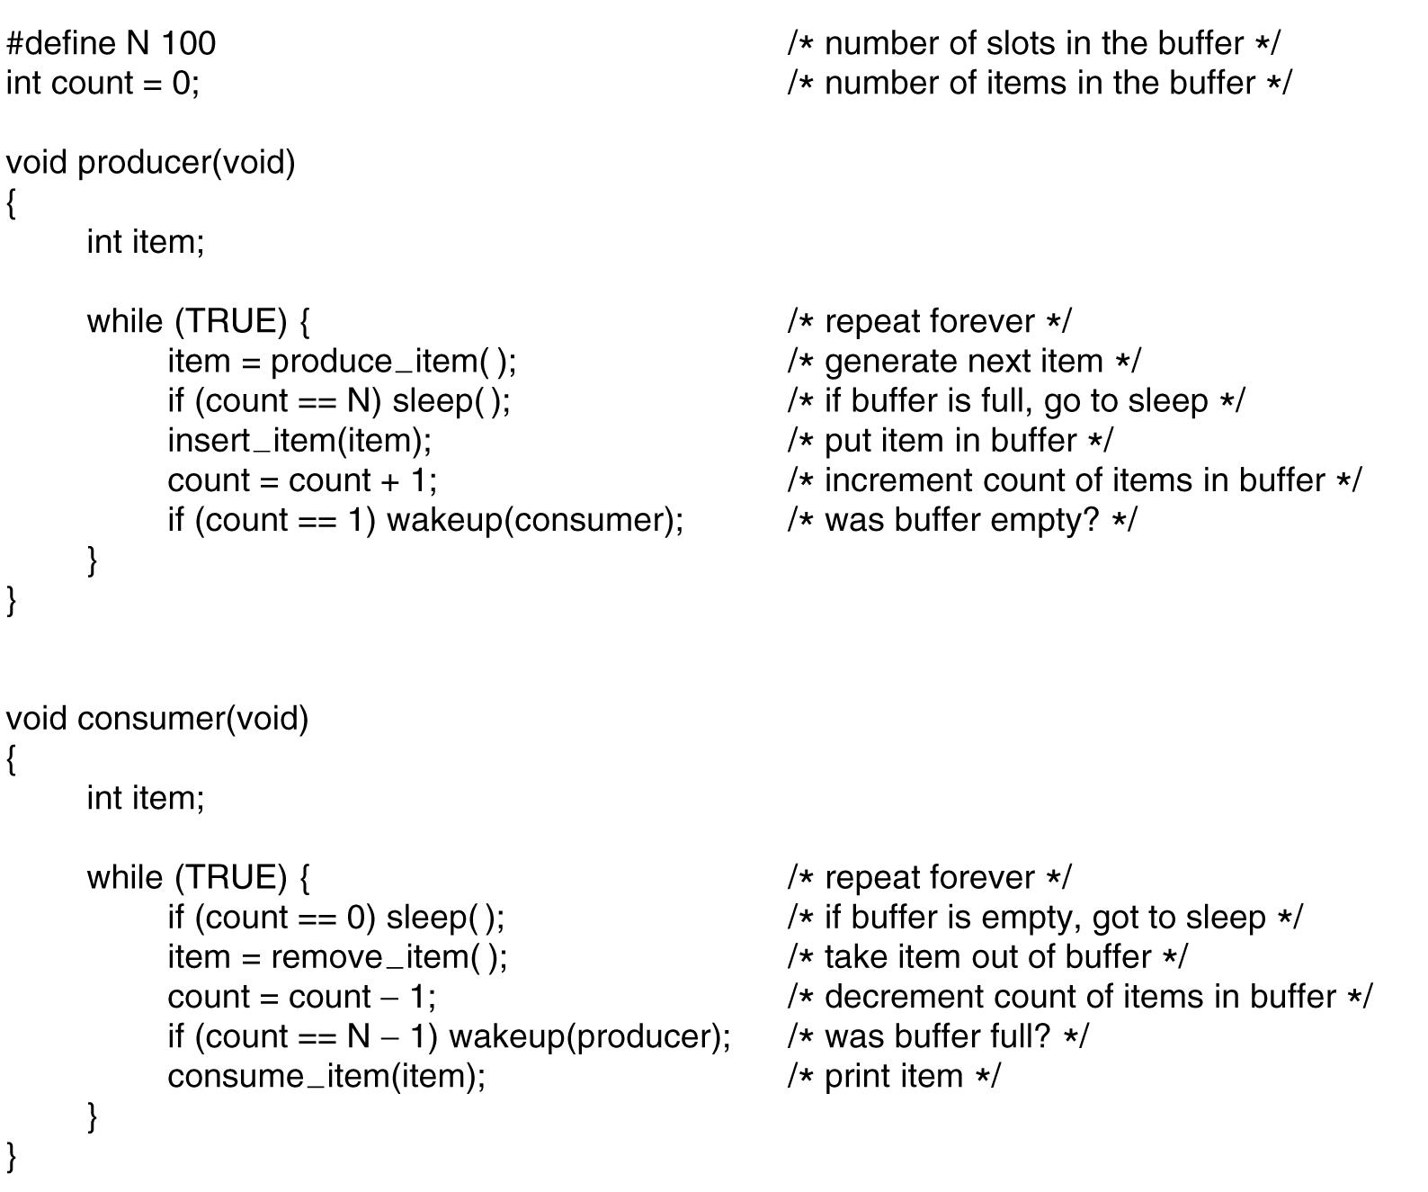
The Producer-Consumer Problem (aka Bounded Buffer Problem)
. . .
Tanenbaum, Modern Operating Systems 3 e, (c) 2008 Prentice-Hall, Inc. All rights reserved. 0-13-6006639

Slide 37
The problem with sleep and wake-up calls
Empty buffer,count==0
Consumer gets replaced by producer before it goes to sleep
Produces something, count++, sends wakeup to consumer
Consumer not asleep, ignores wakeup, thinks count= = 0, goes to sleep
Producer fills buffer, goes to sleep
P and C sleep forever
So the problem is lost wake-up calls
Tanenbaum, Modern Operating Systems 3 e, (c) 2008 Prentice-Hall, Inc. All rights reserved. 0-13-6006639

Slide 38
Semaphores
Semaphore is an integer variable
Implemented by OS
Used to sleeping processes/wakeups
Two operations, down and up
Down checks semaphore. If not zero, decrements semaphore. If zero, process goes to sleep
Up increments semaphore. If more then one process asleep, one is chosen randomly and enters critical region (first does a down)
ATOMIC IMPLEMENTATION-interrupts disabled
E. W. Dijkstra (1965)
Tanenbaum, Modern Operating Systems 3 e, (c) 2008 Prentice-Hall, Inc. All rights reserved. 0-13-6006639

Slide 39
Semaphores
Binary Semaphore
> Binary semaphores are binary, they can have two values only; one to represent that a process/thread is in the critical section(code that access the shared resource) and others should wait, the other indicating the critical section is free.
> semaphores which are restricted to the values 0 and 1 (or locked/unlocked, unavailable/available) are called binary semaphores and are used to implement locks
Counting Semaphore

Slide 40
Counting Semaphores. Conceptually, a semaphore is a nonnegative integer count.
Semaphores are typically used to coordinate access to resources, with the semaphore count initialized to the number of free resources.

Slide 41
Producer Consumer with Semaphores
3 semaphores: full, empty and mutex
Full counts full slots (initially 0)
Empty counts empty slots (initially N)
Mutex protects variable which contains the items produced and consumed

Slide 42
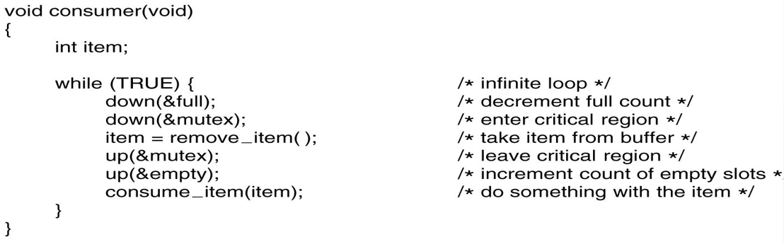
Producer Consumer with semaphores

